Slide 1
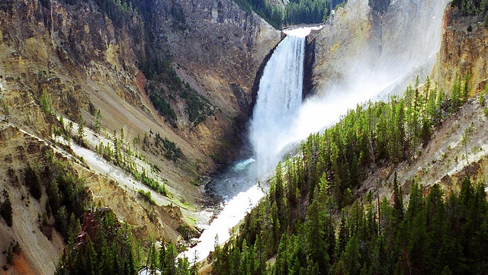
This Photo by Unknown Author is licensed under CC BY-NC

Slide 2
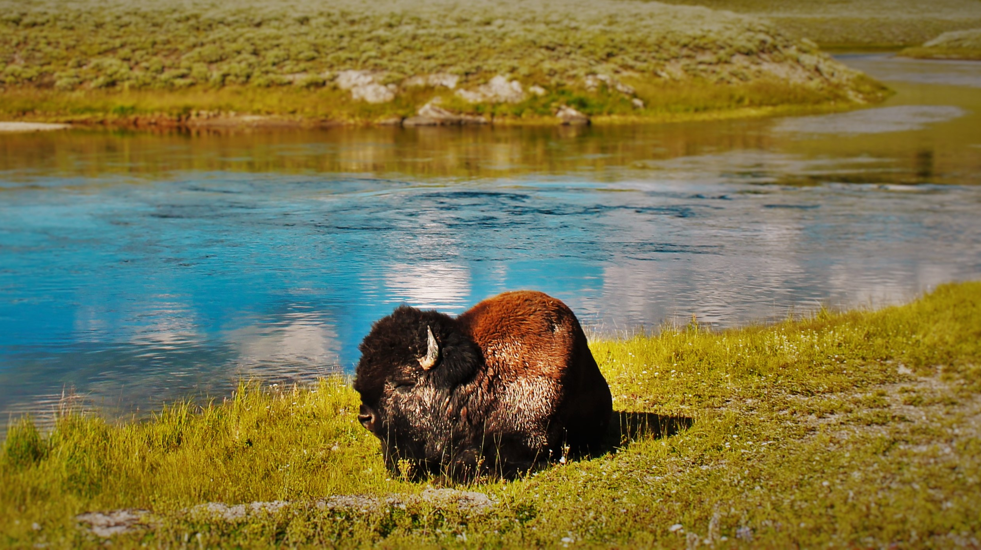
This Photo by Unknown Author is licensed under CC BY

Slide 3
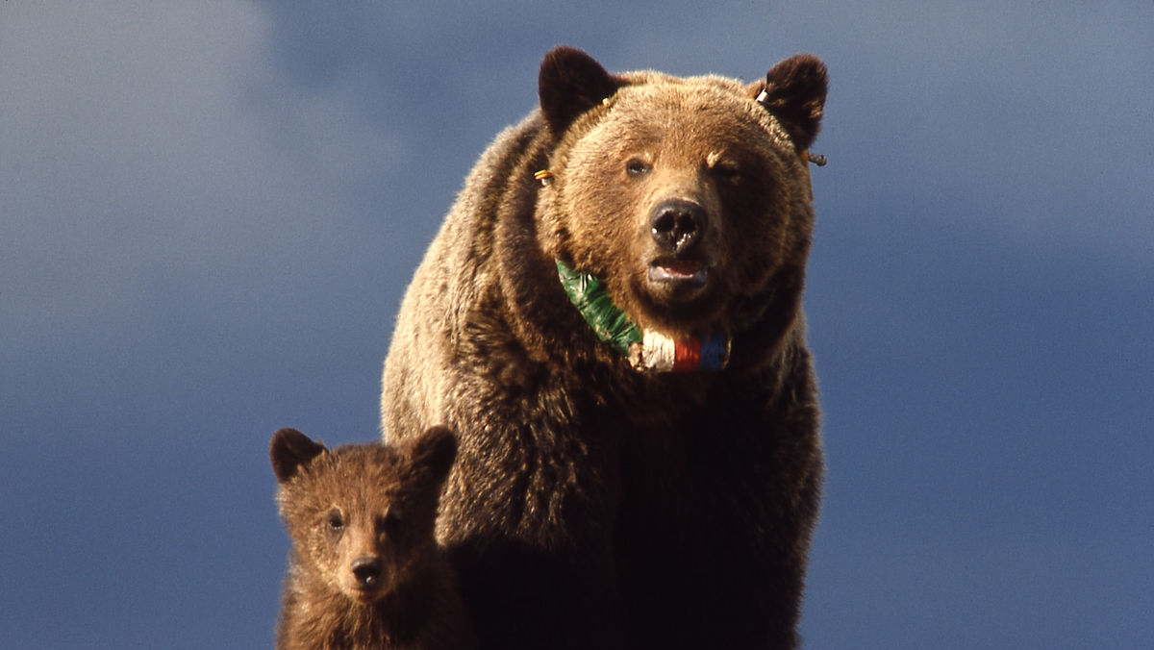
This Photo by Unknown Author is licensed under CC BY-SA

Slide 4
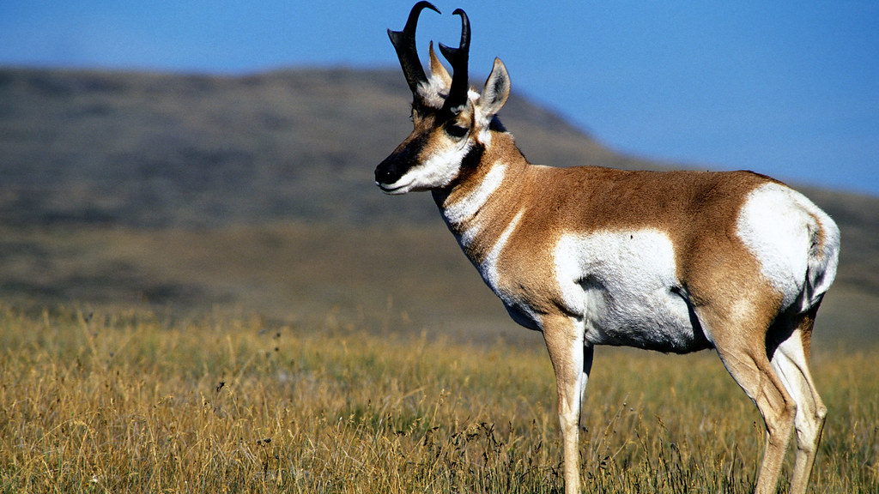
This Photo by Unknown Author is licensed under CC BY

Slide 5
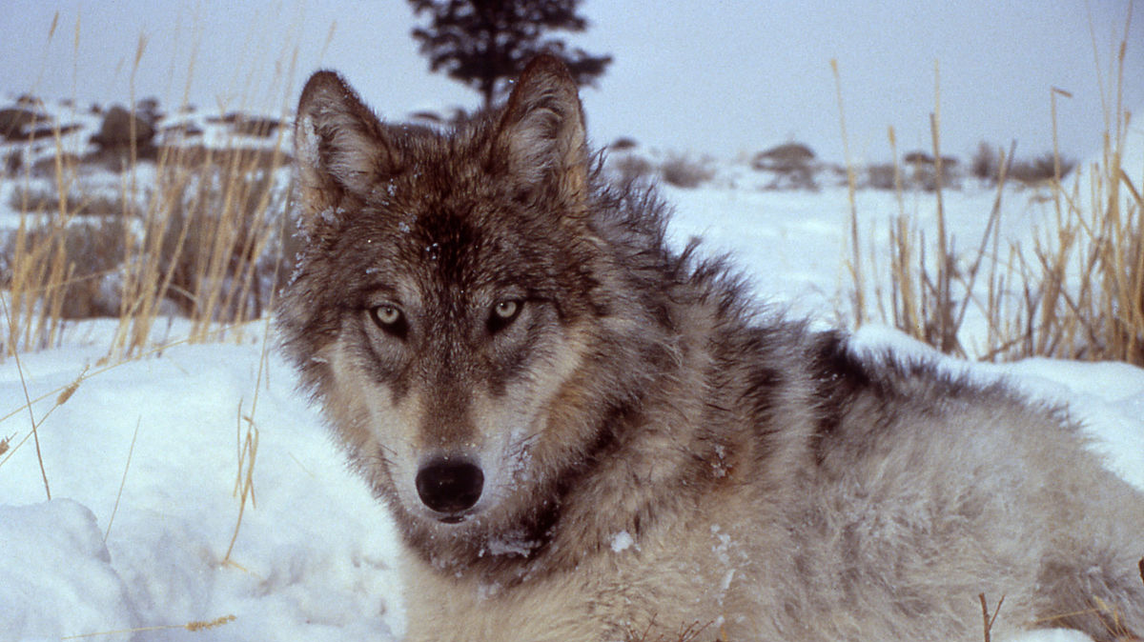
This Photo by Unknown Author is licensed under CC BY-SA

Slide 6
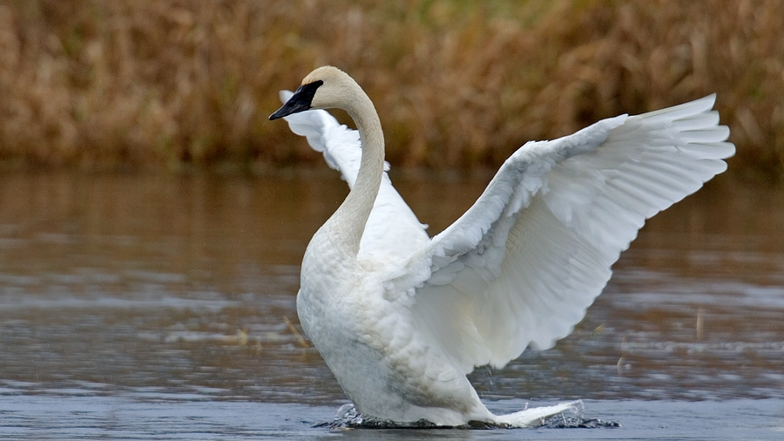
This Photo by Unknown Author is licensed under CC BY-SA-NC

Slide 7
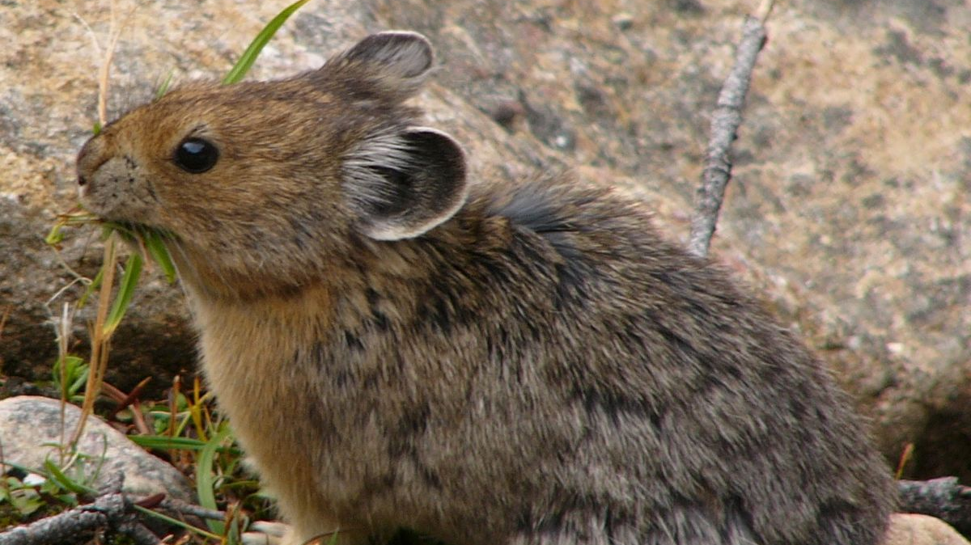
This Photo by Unknown Author is licensed under CC BY-SA

Slide 8
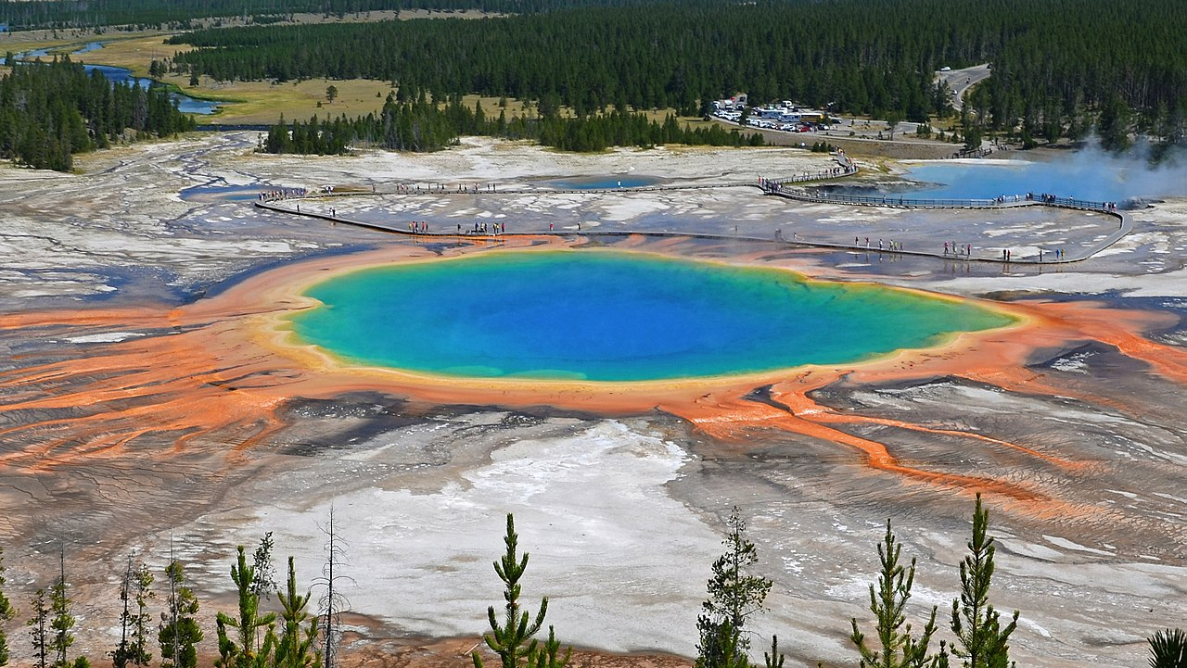
This Photo by Unknown Author is licensed under CC BY-SA

Slide 9
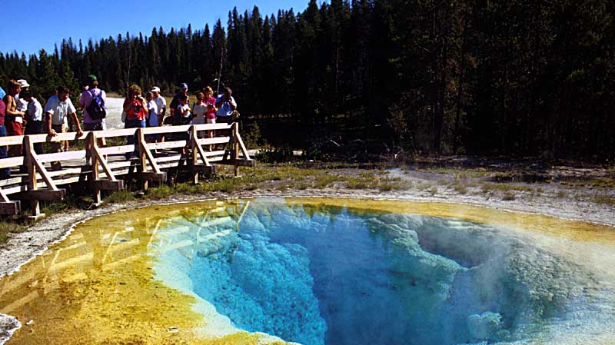
This Photo by Unknown Author is licensed under CC BY-SA

Slide 10
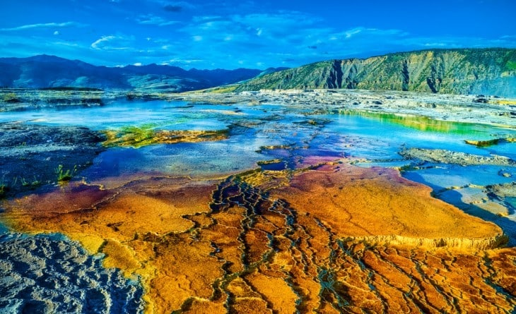
This Photo by Unknown Author is licensed under CC BY-SA

Slide 11
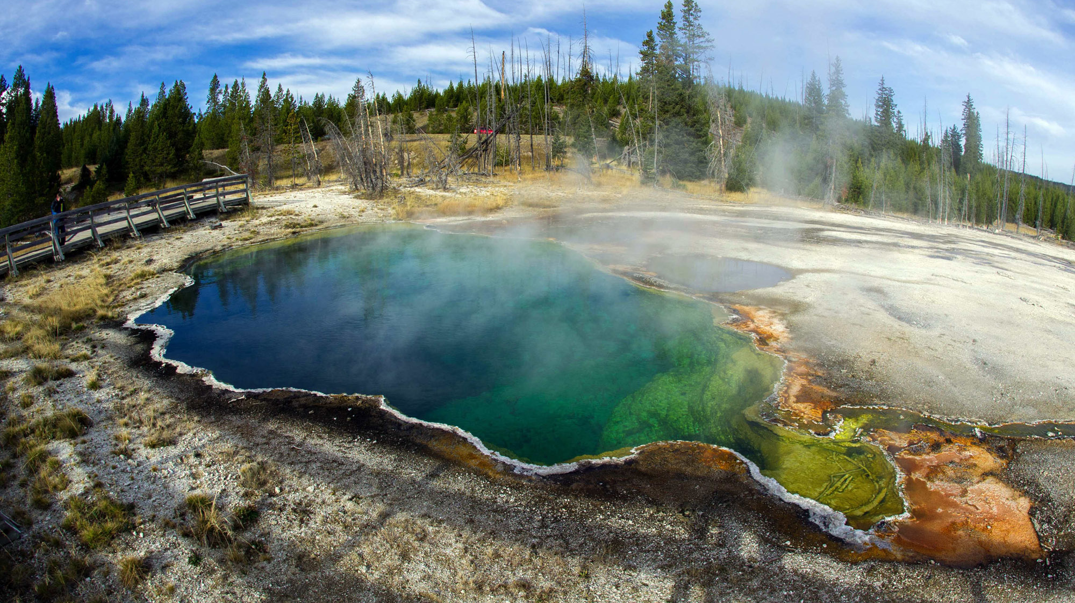
This Photo by Unknown Author is licensed under CC BY-NC-ND

Slide 12
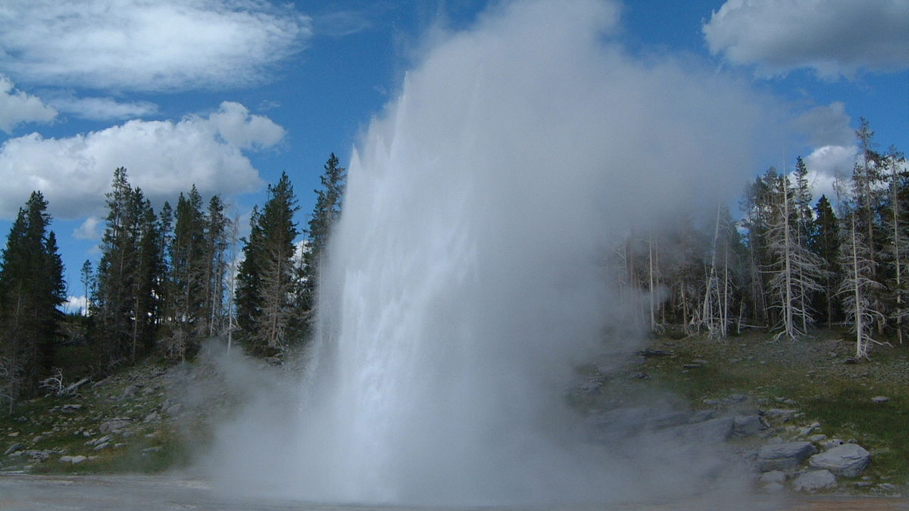
This Photo by Unknown Author is licensed under CC BY-SA

Slide 13
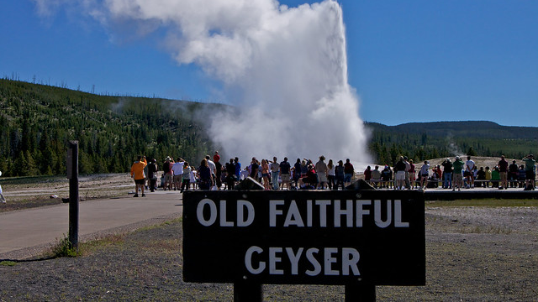
This Photo by Unknown Author is licensed under CC BY-SA

Slide 14
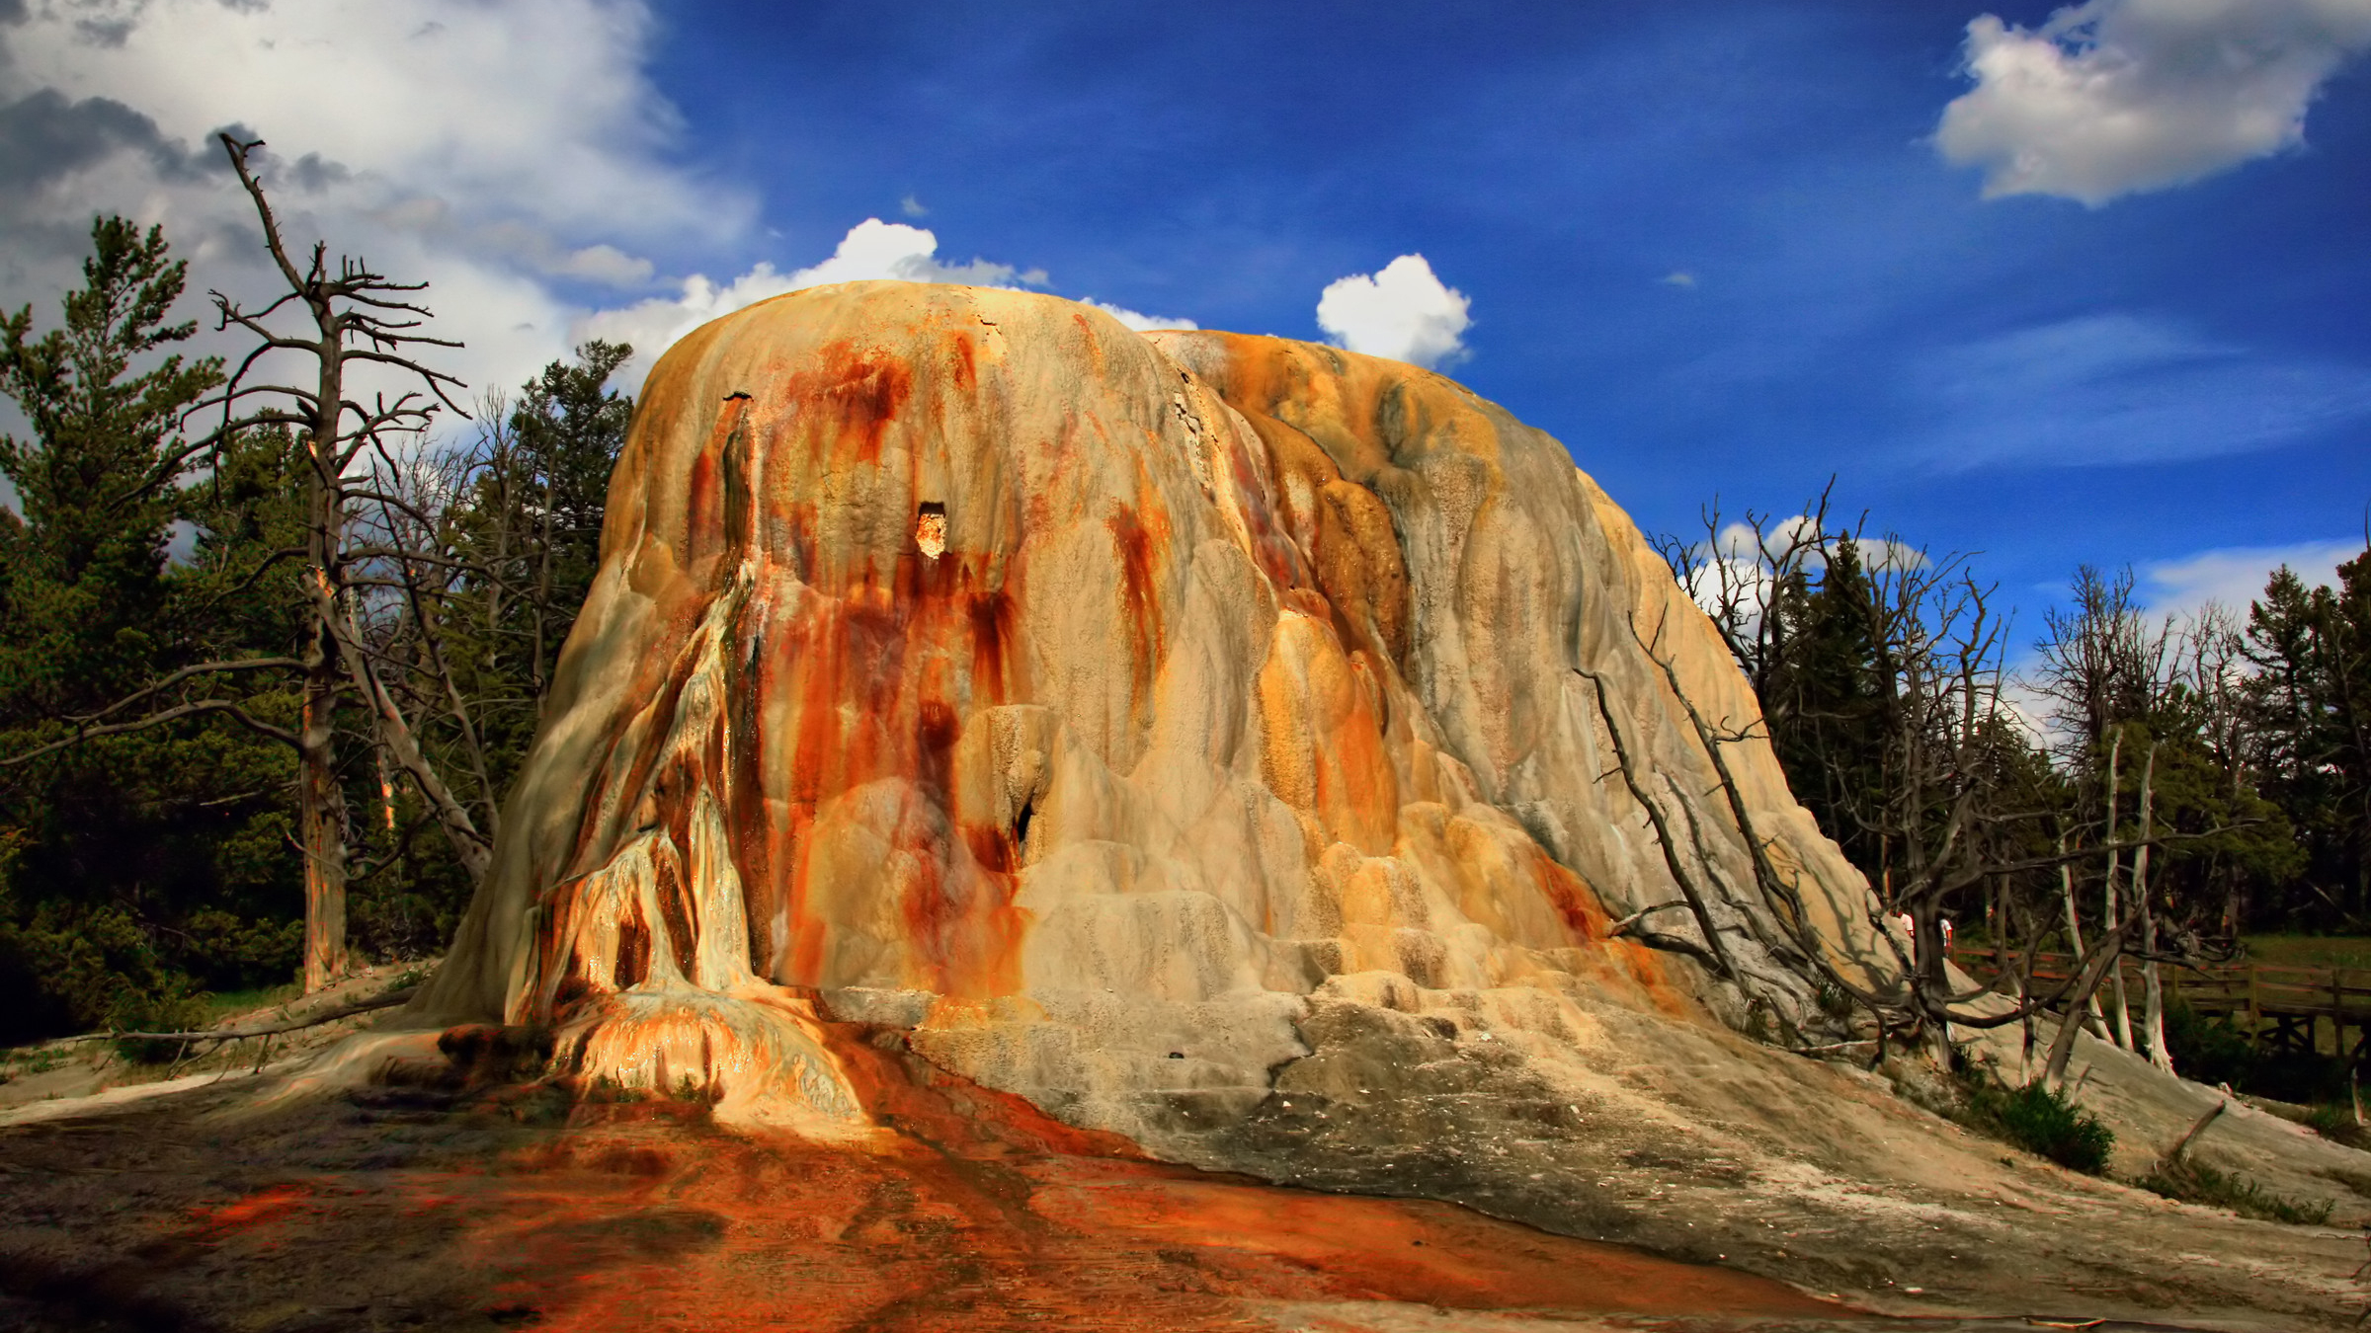
This Photo by Unknown Author is licensed under CC BY-SA

Slide 15
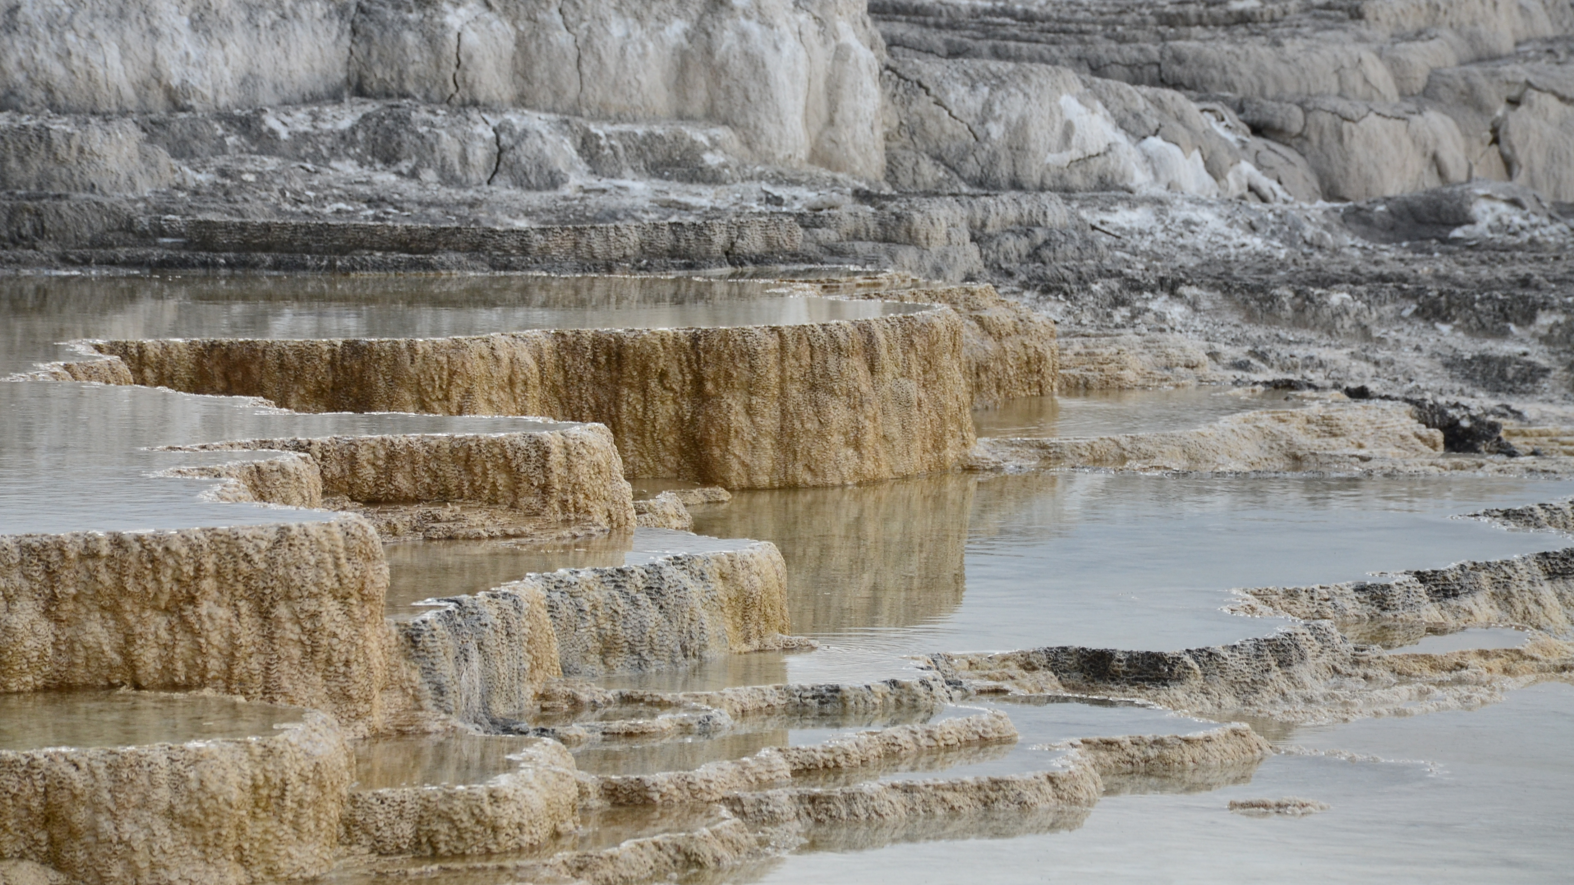
This Photo by Unknown Author is licensed under CC BY-NC-ND

Slide 16
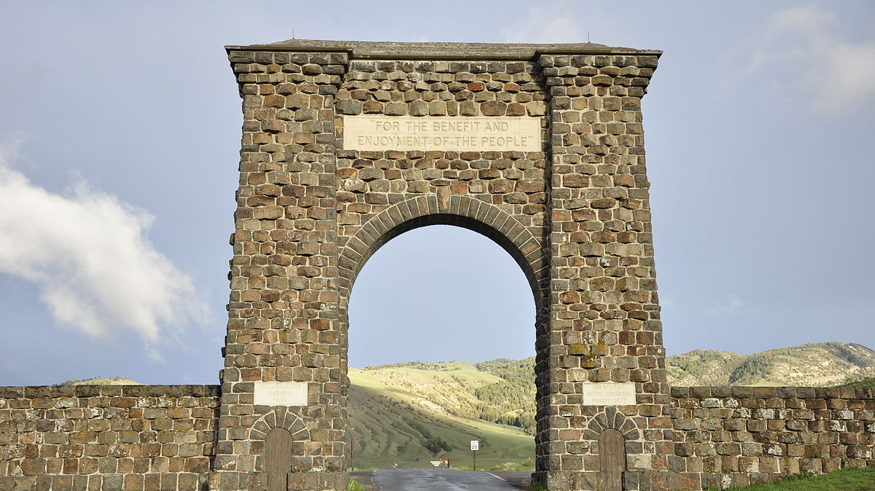
This Photo by Unknown Author is licensed under CC BY-SA

Slide 17
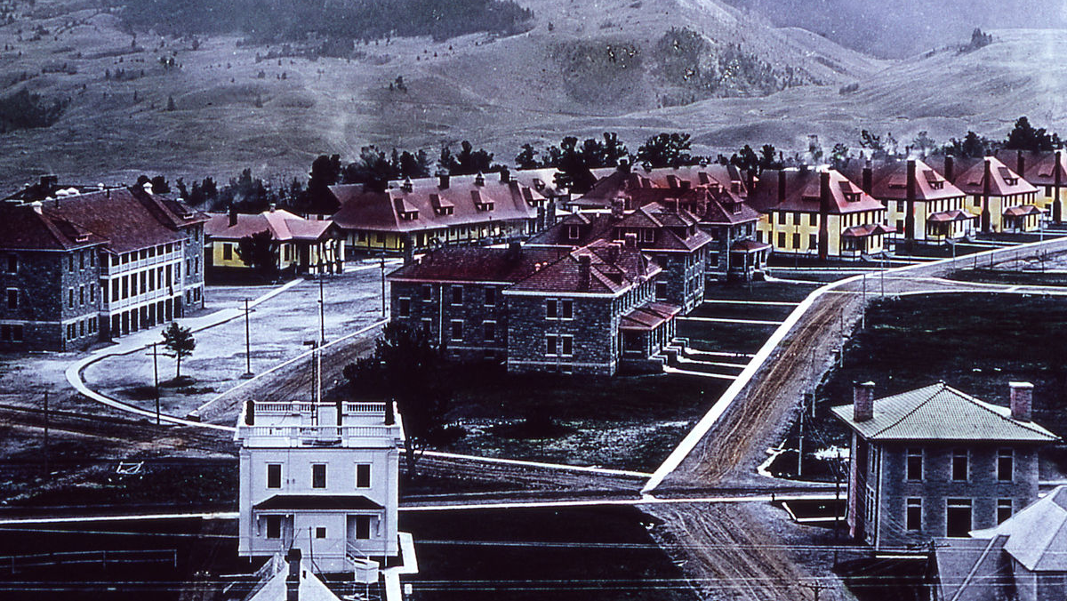
This Photo by Unknown Author is licensed under CC BY-SA

Slide 18
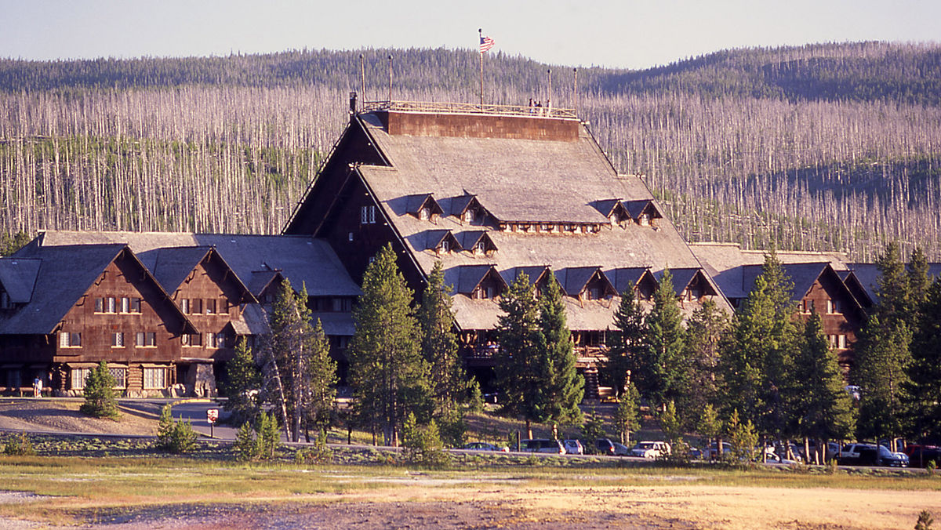
This Photo by Unknown Author is licensed under CC BY-SA

Slide 19
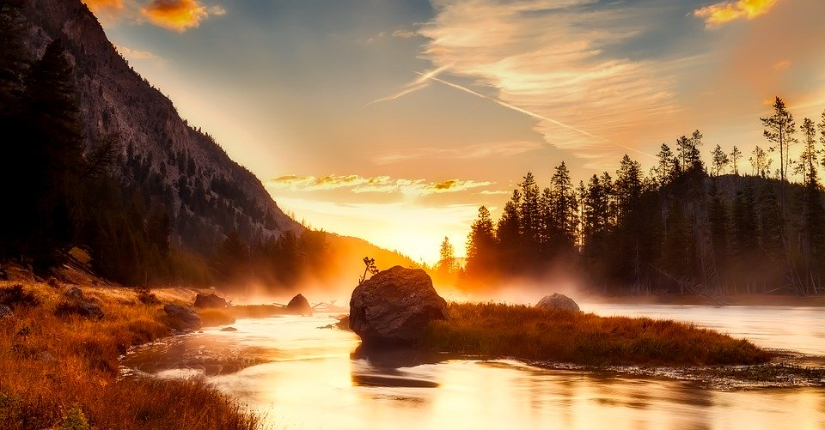

Slide 20
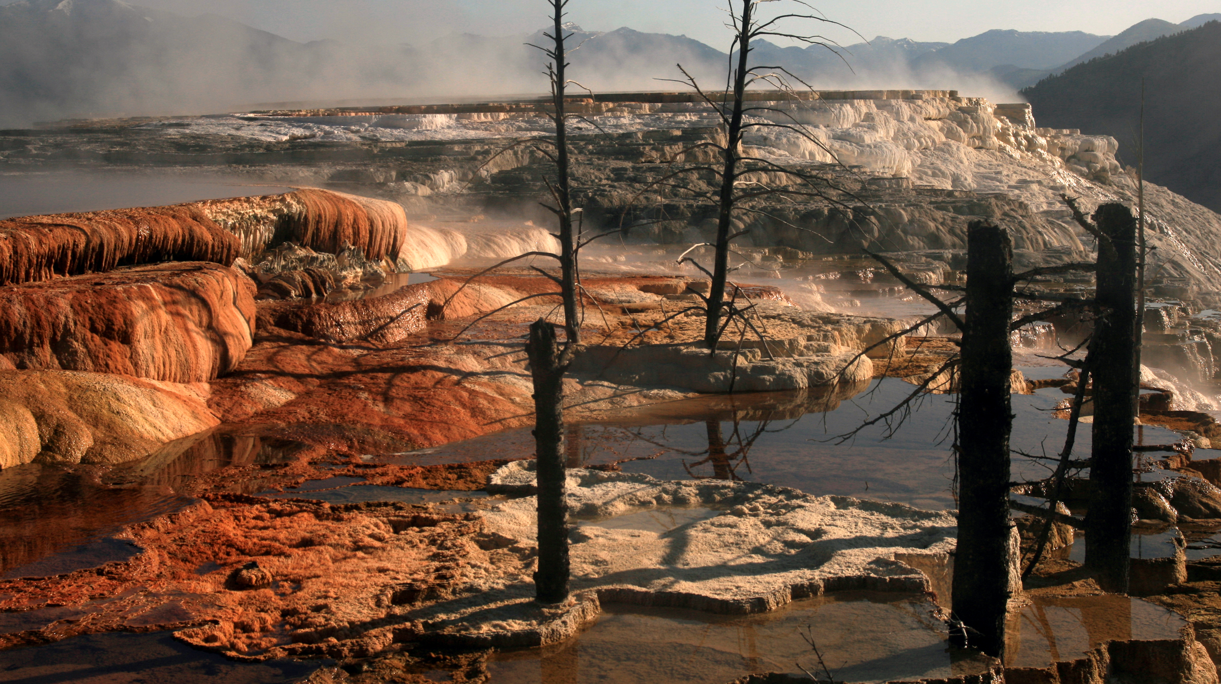
This Photo by Unknown Author is licensed under CC BY-NC-ND

