Slide 1
Ally as a Tool for Universal Design for Learning in Higher Education
Suzanne Kucharczyk, EdD
suzannek@uark.edu
Renee Speight, PhD
rspeight@uark.edu

Slide 2
Our Obligation
From: CAST http://udloncampus.cast.org/page/policy_legal
Students with Disabilities must be provided the opportunity to:
Acquire the same information
Engage in same interactions,
Enjoy the same services
With ”substantially equivalent ease of use”
(2010) US Department of Justice – Civil Rights Division - and US Department of Education – Office of Civil Rights

Slide 3
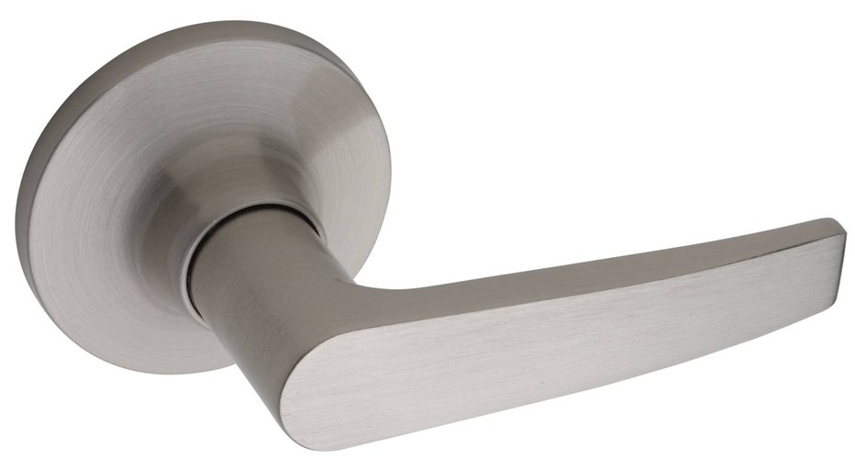
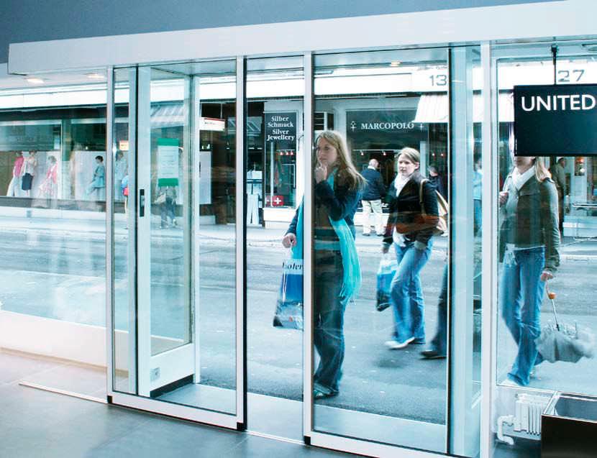
Barriers to Access
www.directdoorhardware.com
http://www.archiexpo.com/prod/kaba-saflok/product-59355-1226003.html

Slide 4
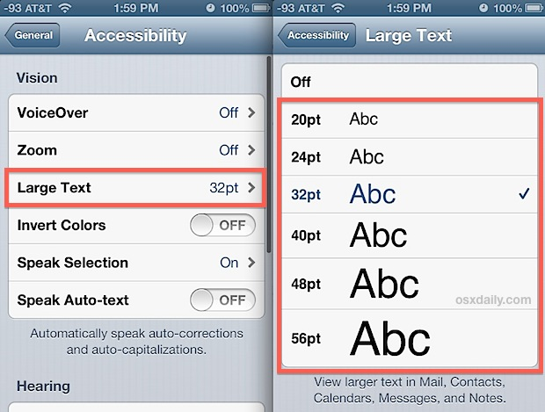
Universal Design
Architectural term coined by R. Mace
Is our physical environment welcoming and accessible?
Intentional design
Proactive
Anticipates needs
Broadens usability
Respects diversity
Esthetically thoughtful

Slide 5
Ensuring access, understanding, participation, and expression of learning in a way that can be measured THROUGH multiple ways of …
Expression
Engagement

Slide 6
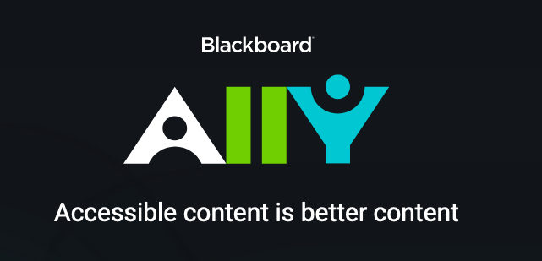
Ally and UDL
How Ally checks the UDL boxes:
Intentional design
Proactive
Anticipates needs
Broadens usability
Respects diversity
Esthetically thoughtful

Slide 7
Ally in Blackboard

Slide 8
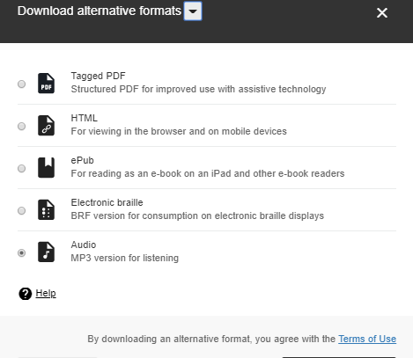
With a Perfect Accessibility Rating

Slide 9
Ally in Blackboard

Slide 10
How does this tool work?

Slide 11
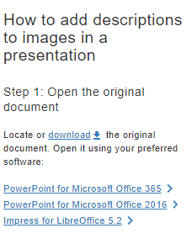
How does this tool work?

Slide 12
Include a description of this image to improve accessibility

Slide 13
How does this tool work?
Most often associated with PDFs
Best way to combat?
Upload the original PPT or Word Doc

Slide 14
Most Common Barriers
Untagged PDFs
Tables without headers
Images without descriptions

Slide 15
Ally and UDL
How Ally checks the UD boxes:
Intentional design
Proactive
Anticipates needs
Broadens usability
Respects diversity
Esthetically thoughtful

Slide 16
Accessibility Resources
UDL in Higher Education http://udloncampus.cast.org/page/udl_landing
Ally tool website https://ally.ac/
Global Instructional Designers https://globalcampus.uark.edu/instructional-designers/
U of A Center for Educational Access https://cea.uark.edu/
Microsoft Accessibility Guides https://www.microsoft.com/en-us/accessibility/resources?activetab=pivot_1:primaryr7

